Slide 1


Slide 2
What is a spoiler?
Critical plot information about works of fiction that “spoil” a viewer’s enjoyment.
We deal with the spoilers in the field of entertainment.
Google Chrome Spoiler Detectors

Slide 3

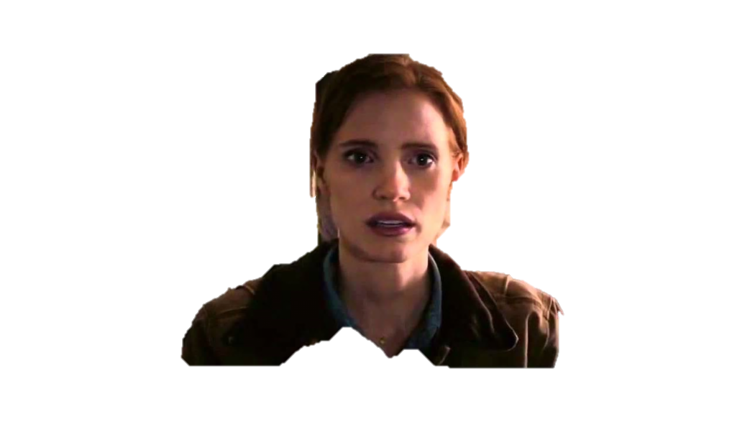
THE NEED FOR AUTOMATIC SPOILER DETECTION
“Spoilers” have the potential to kill the joy of an entertainment
Experience.
Is it important to detect spoilers?
The scope of the project
GOT SPOILER
My dad was my ghost

Slide 4
Our attempt is to automatically filter these spoilers using some Machine Learning and Natural
Language processing techniques!

Slide 5
What were the previous attempts?
Policy for spoiler detection using manual annotation .
Spoiler detection using transitivity and narrative natures.

Slide 6
So, why is this project different?
And can we expect success from this project?
TV Tropes is a wiki that collects and expands descriptions
and examples on various conventions and devices (tropes)
found within creative works.

Slide 7

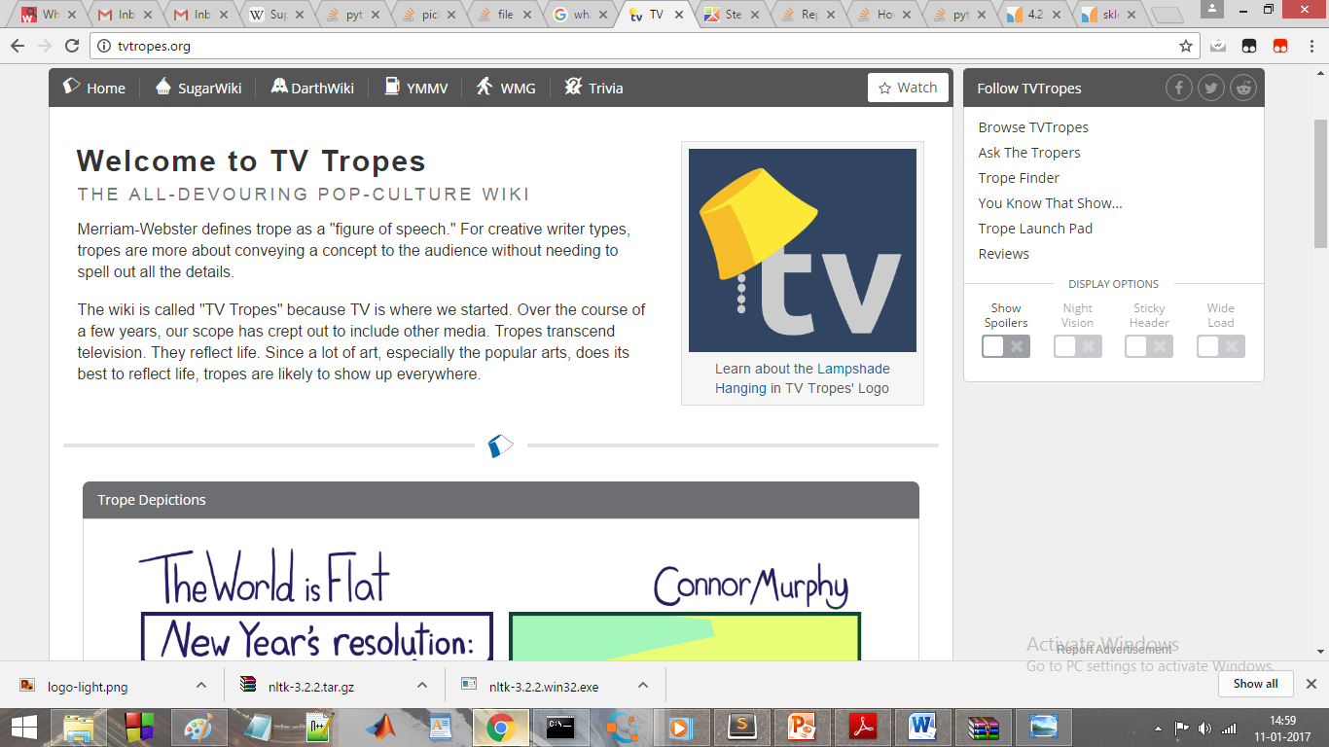

Slide 8
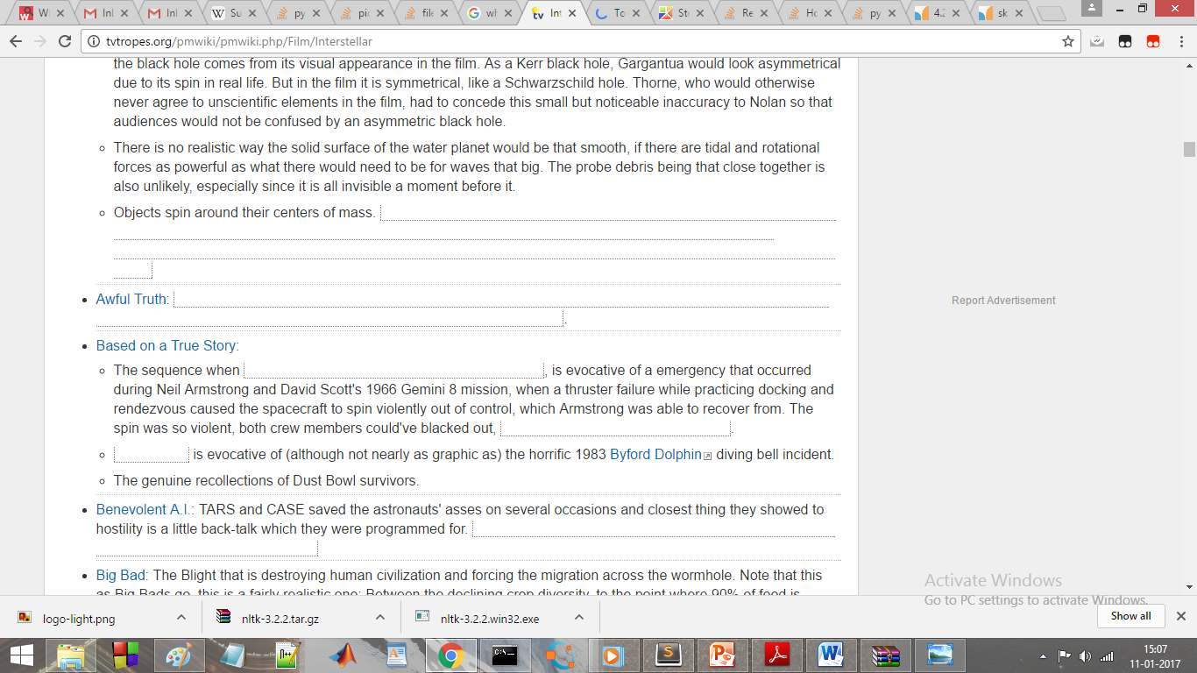
HTML TAGS

Slide 9
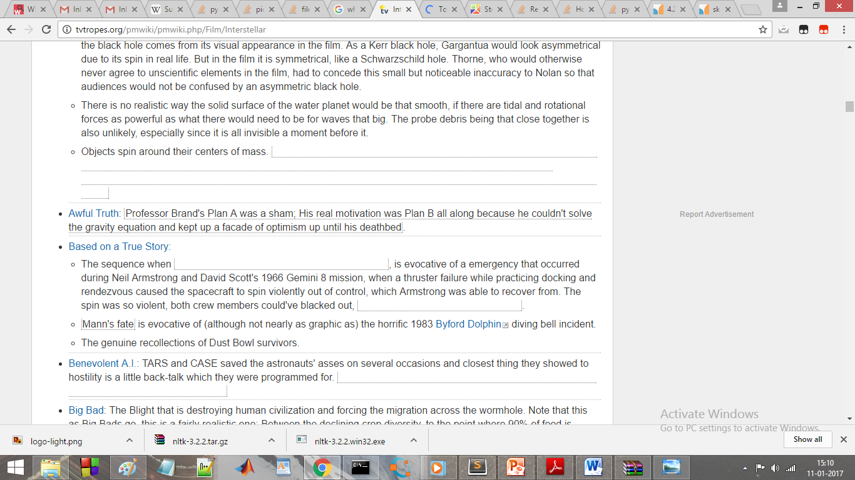

Slide 10
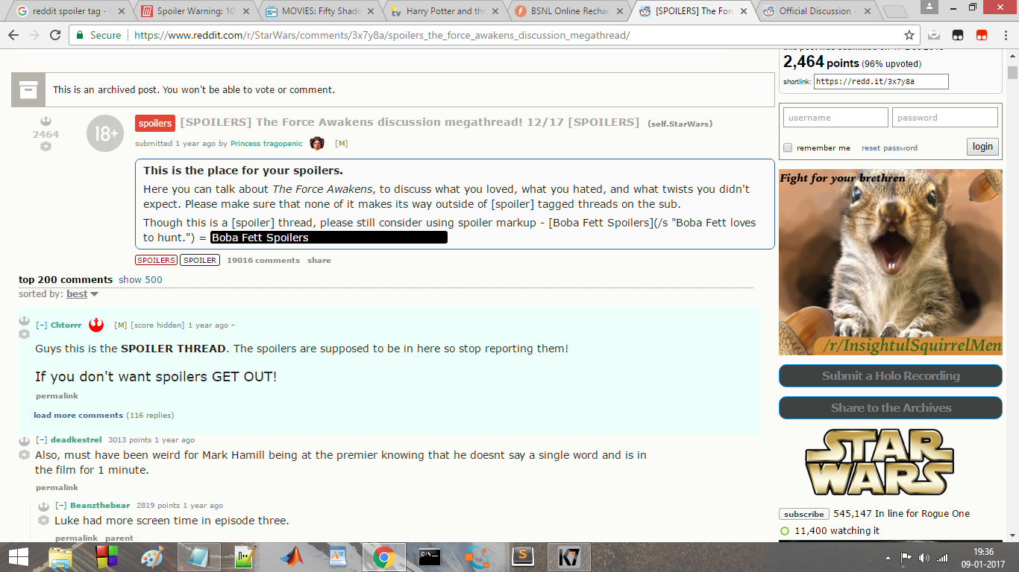
HTML TAGS

Slide 11
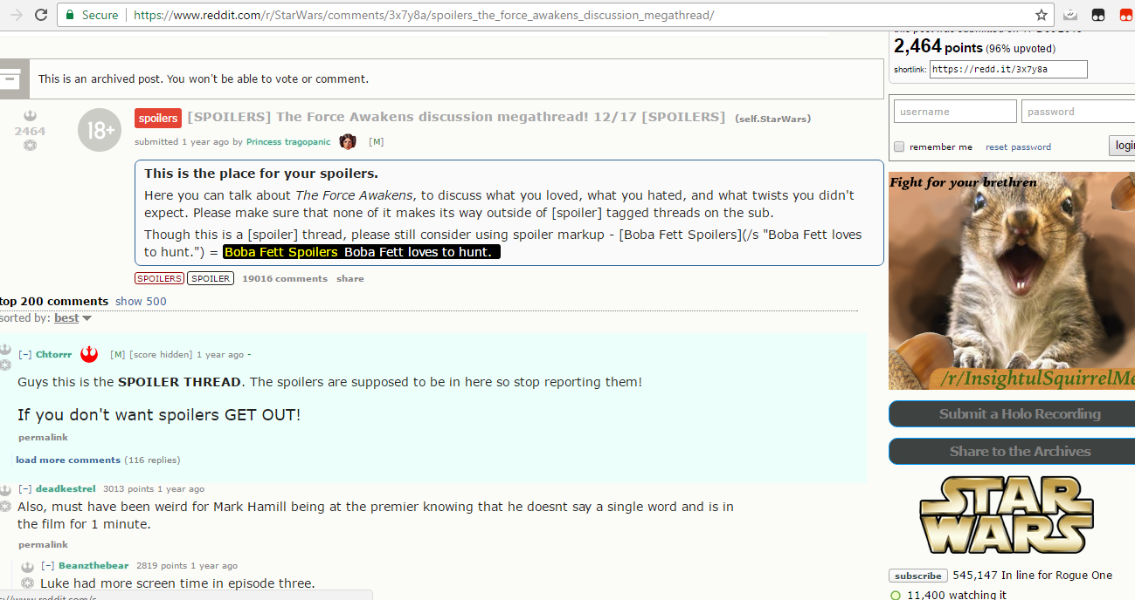

Slide 12
PROCEDURE FOLLOWED IN THE PROJECT
STEP 1: Develop a data set of spoilers gathered using automatic classifiers using machine learning techniques.
STEP 2: Using Support vector Machines and Natural language
processing, we develop Metadata- based features that substantially
improve performance on spoiler detection task.

Slide 13
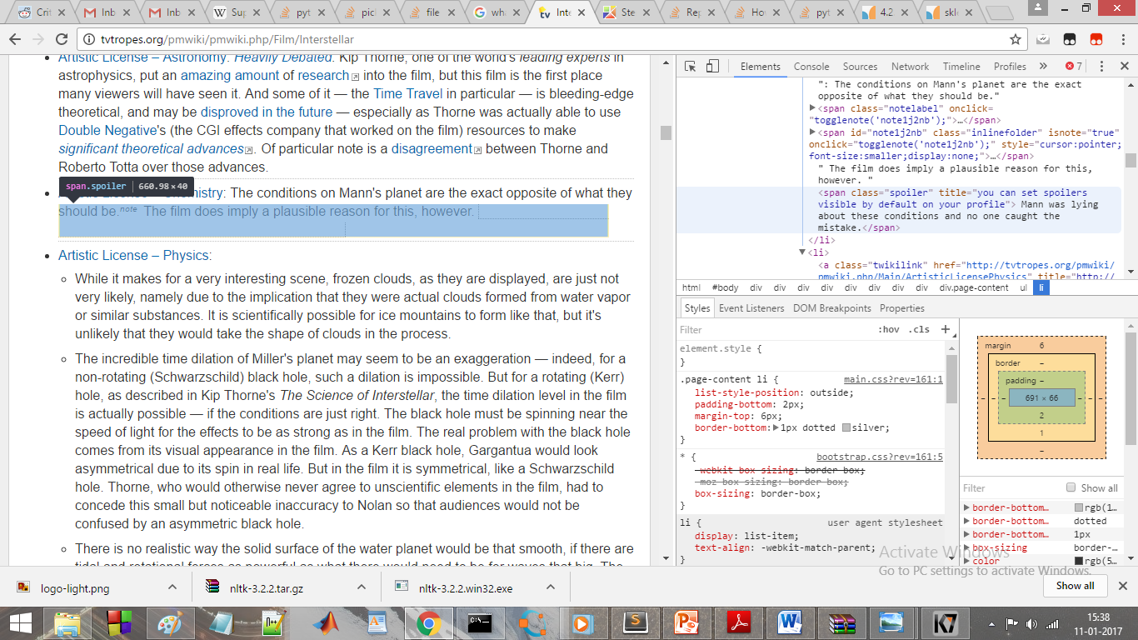

Slide 14
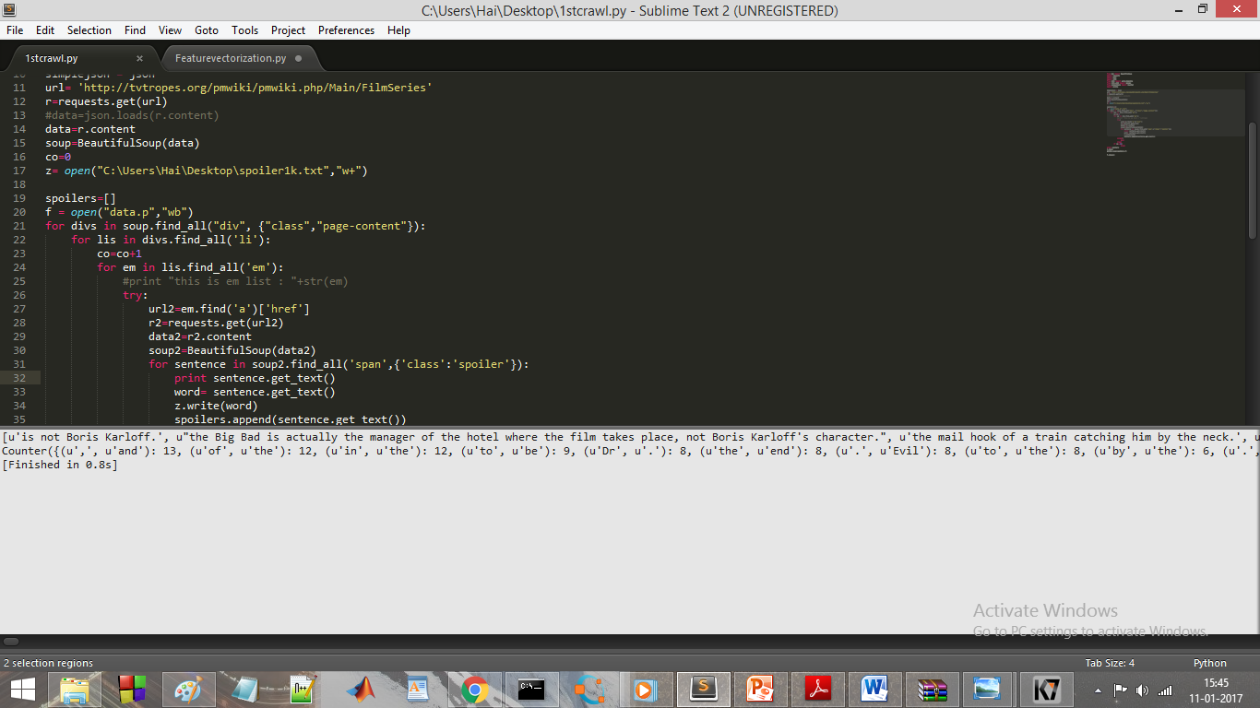

Slide 15
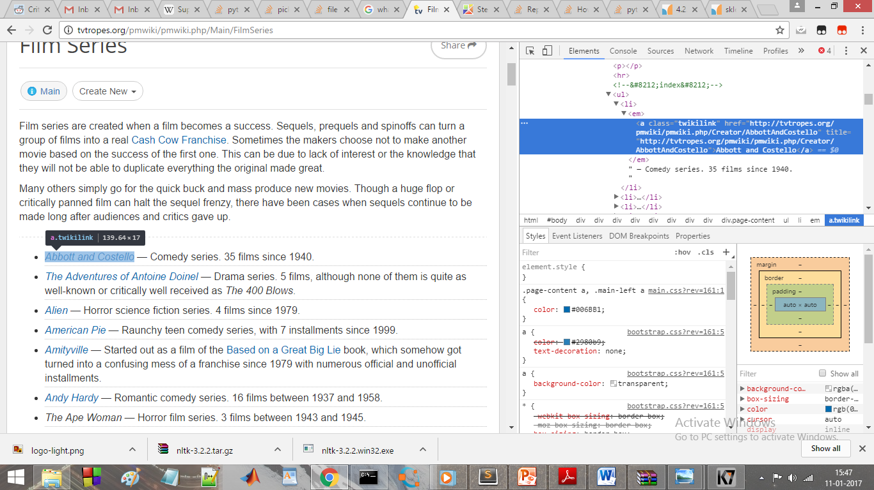

Slide 16
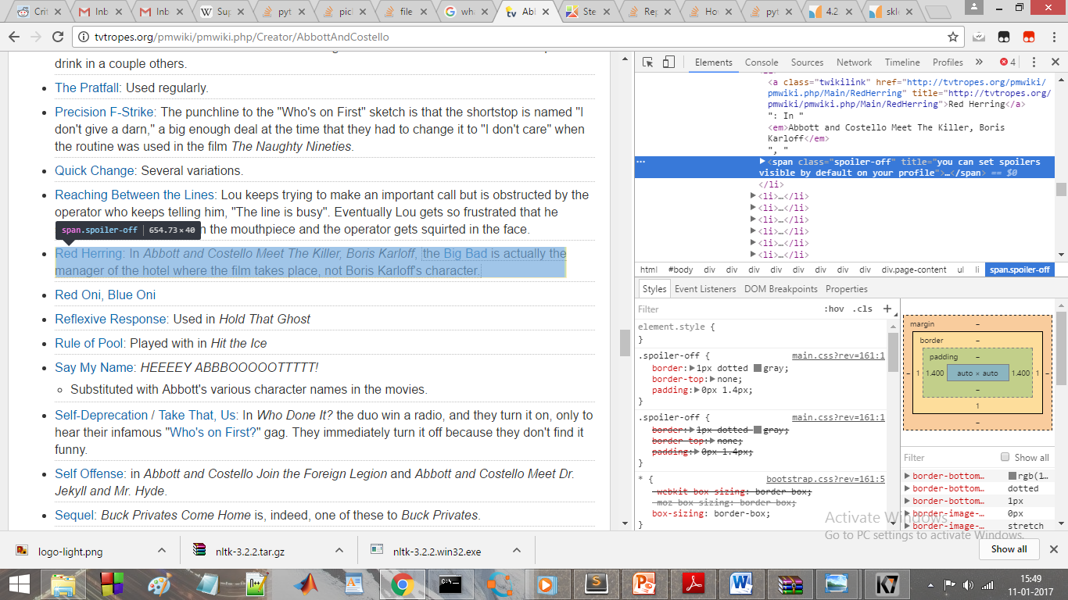

Slide 17
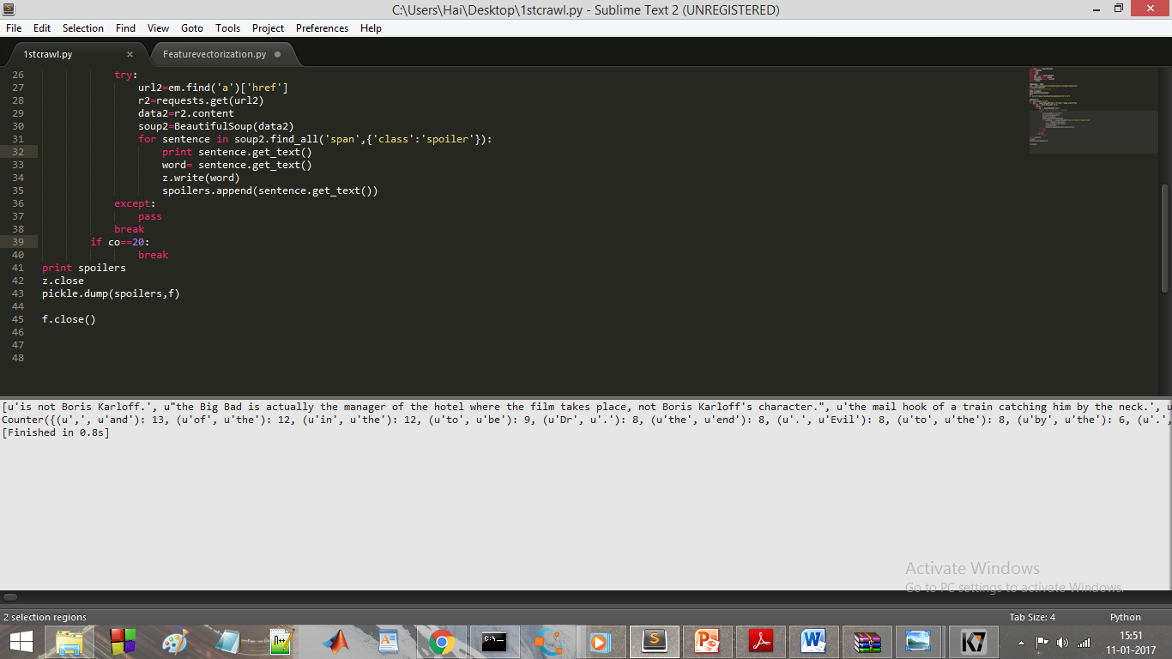

Slide 18
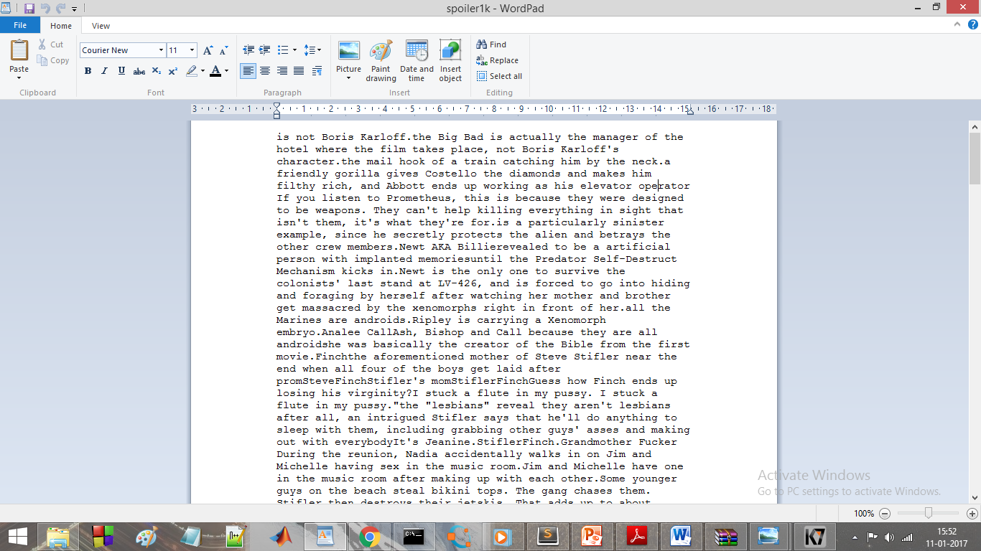

Slide 19
We create a balanced dataset (an equal number of spoiler
and non-spoiler sentences).
Unigram uses only single word tokens from the originalsentence
Stem uses only single word tokens, but reduces each token
to a stem (Porter, 1980) of each unigram (i.e., “runs”
becomes “run” and “quicker” becomes “quick”); and
Bigram uses all consecutive pairs of tokens from the original
sentence. This results in a much larger feature space,
but can capture important contextual information lost to the
“bag of words” model.

Slide 20
FEATURES FOR DETECTING SPOILERS
Genre :
Media are often sorted by genre; IMDb categorizes every movie and television show into a set of overlapping categories. This can be a reflection of the target audience (“Family” or “Adult”), the subject (“Crime” or “Sci-Fi”), or the way the
subject is presented (“Comedy” or “Short”).
Length:
The length of a work serves as a useful indicator of whether it is likely to have a spoiler. As seen in Figure 1a, longer works are more likely to have a spoiler than shorter works. This is a function both of format and genre. First, length is often correlated with genre; comedies are more likely to be thirty
minutes, while dramas are more likely to be one hour.
First Aired
Because TV Tropes concerns all media, not just recent productions,
there is a diverse range of works discussed on the
site. If the algorithm knows when the work was created, it can
better replicate the collective decision about which sentences
are spoilers or not.

Slide 21
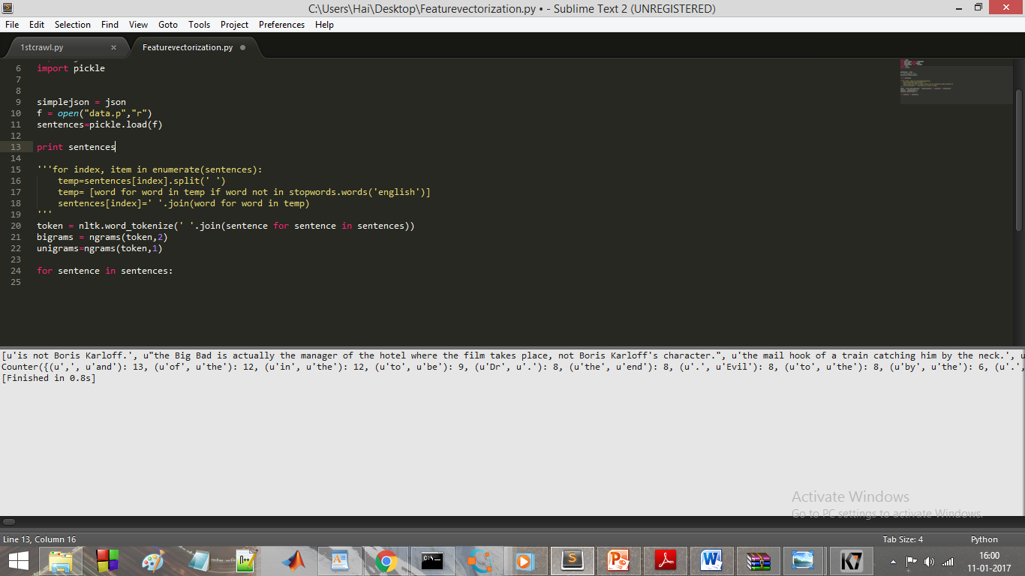

Slide 22
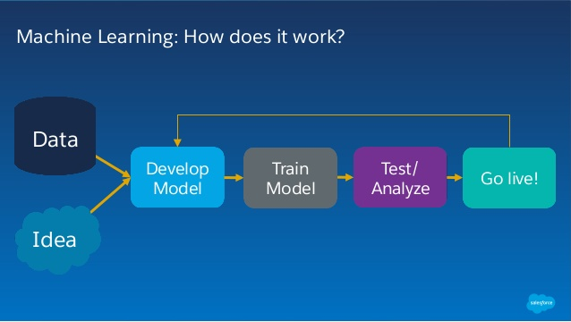

Slide 23
‘Support Vector Machines’ is like a sharp knife – it works on smaller datasets, but on them, it can be much more stronger and powerful in building models.
“Support Vector Machine” (SVM) is a supervised machine learning algorithm which can be used for both classification or regression challenges
In Python, scikit-learn is a widely used library for implementing machine learning algorithms, SVM is also available in scikit-learn library
We plot each data item as a point in n-dimensional space (where n is number of features you have) with the value of each feature being the value of a particular coordinate.

Slide 24
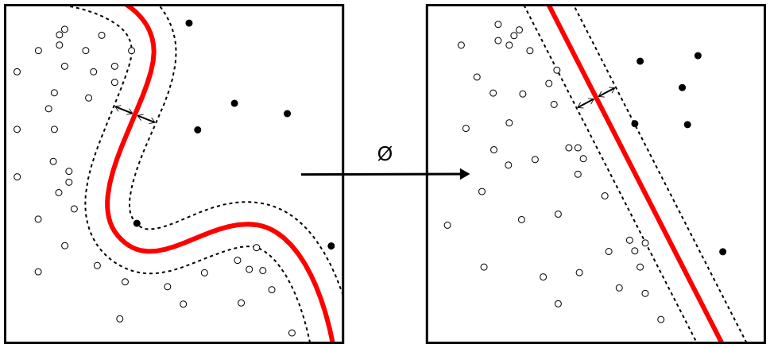
SUPPORT VECTOR MACHINES

Slide 25
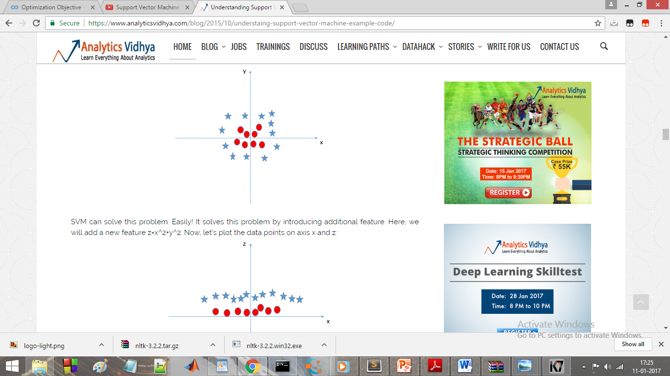

Slide 26
THE END

